Slide 1
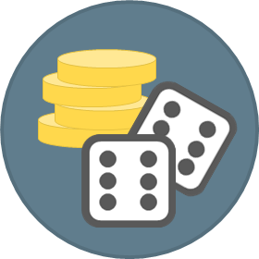
Double Six
FABRIKAM RESIDENCES
Android Application

Slide 2
Double Six Overview
Double Six is a Gaming Application enabling players from around the world to experience a real time dice toss on their mobile devices. Players can connect and place bets for the highest roll of the dice. Players are then rewarded based on their scores in relation to other players’ scores.

Slide 3


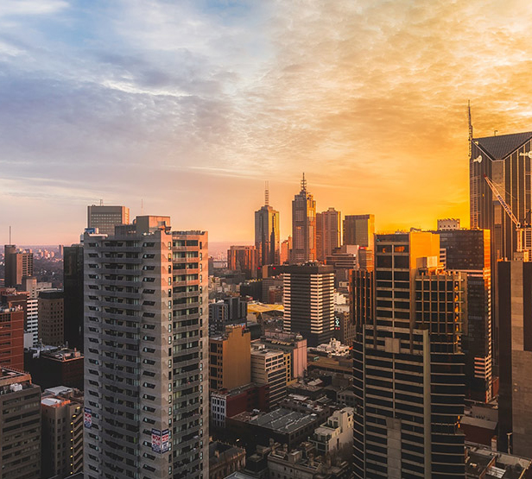
Double Six
Application Sleek UI Design – Tabbed Layout
Tabs organize and allow navigation between groups of content that are related and at the same level of hierarchy.
Each tab contains content that is distinct from other tabs. The tabs in Double Six present different sections of the app; Lobby, Wallet and Miner.
For a fluid, crisp and user friendly interface, Double Six Tab Labels are short and to the point with icons.

Slide 4
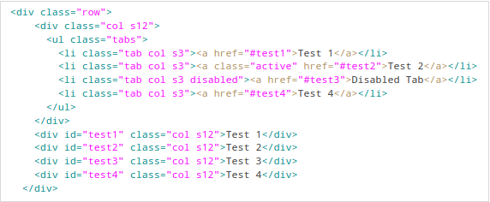
Double Six
Application Sleek UI Design – Tabbed Layout
Double Six Uses the MaterializeCSS framework to achieve Google’s material design with its predefined app components such as tabs.

Slide 5
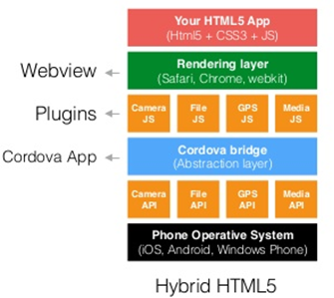
Double Six
Layered Architecture

Slide 6
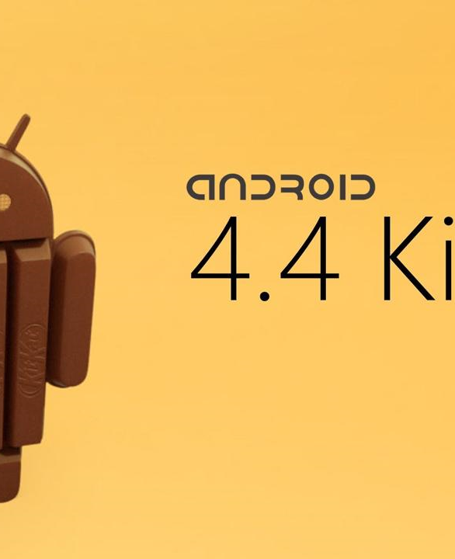
Double Six
Requirements and Configuration
Android OS
Minimum Android Version: 4.4(KitKat) API level 19.
Requires Internet connection
Requires email set up for user verification.
PayPal account

Slide 7
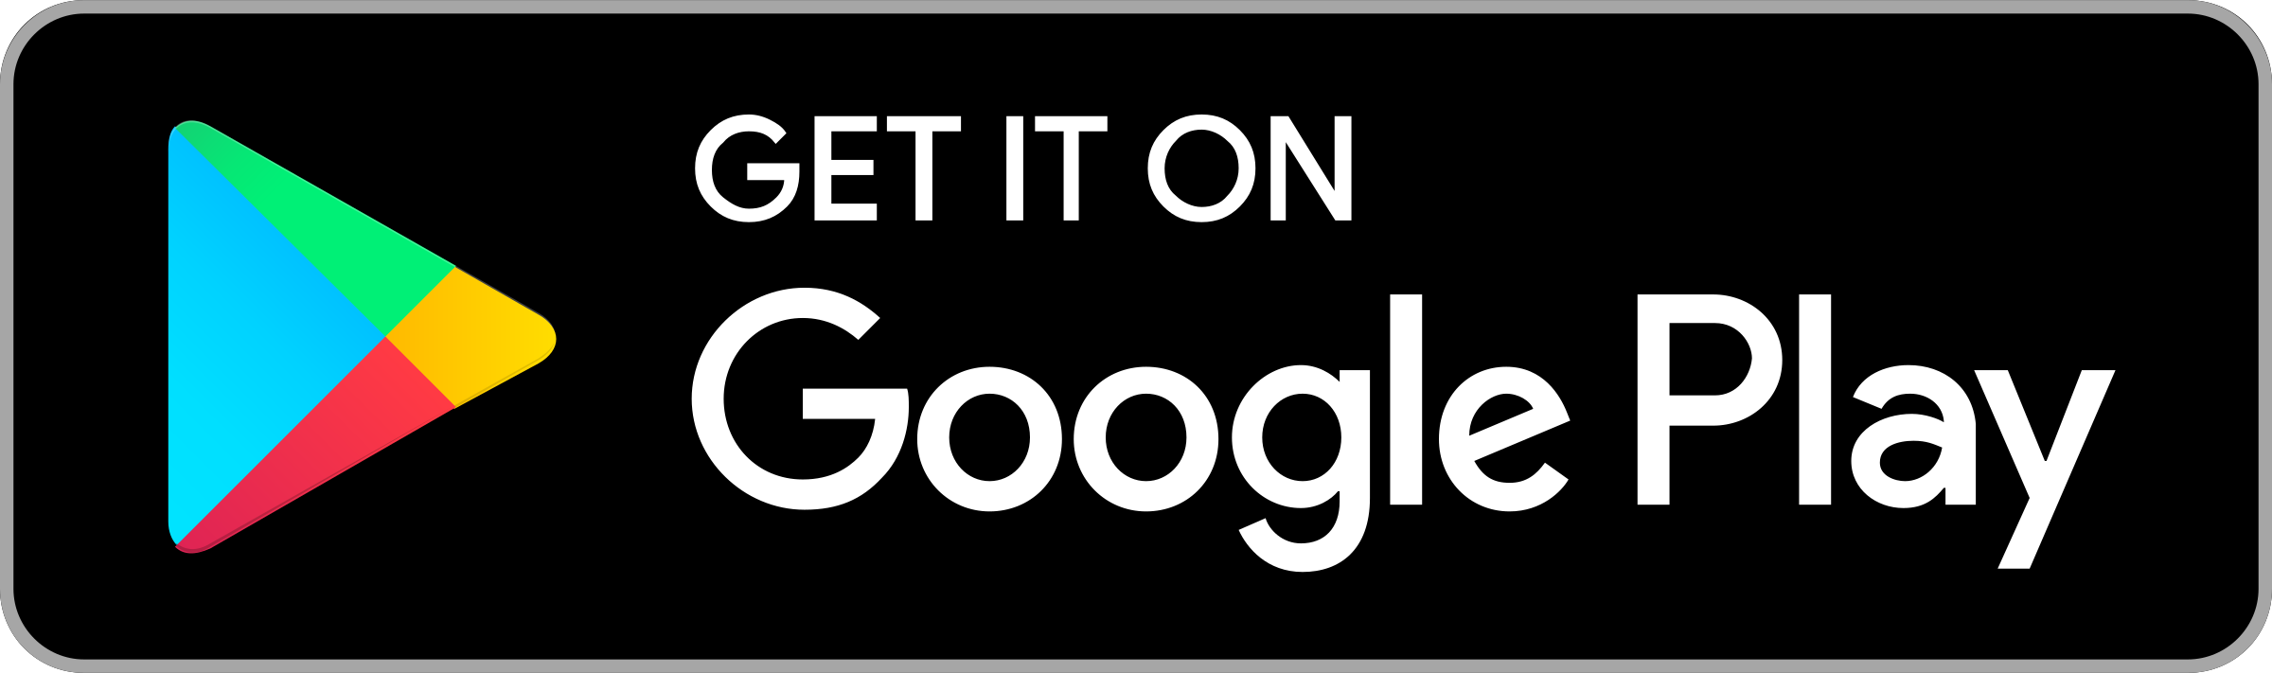
Double Six
DS
Deployment Environment
Google Play Store Overview
Google Play Developer Policy Centre
The number of available apps in the Google play Store was most recently placed at 2.6 million apps in December 2018 after surpassing 1 million apps in July 2013. Google play was originally launched in October 2008 under the name Android Market. As of July 2018, the top grossing Android apps worldwide included gaming apps such as Pokémon Go and Candy Crush Saga. With Gaming being Double Six’ Main Category and Casino it’s sub- category we aim to attract Android Smartphone Users from all over the world. This app is a free to download app and rely on monetization via in-game purchases and advertisements.
Double Six and all its affiliates will abide by all the rules and regulations defined under the Google Developer Policy Centre.
https://play.google.com/about/restricted-content/gambling/gambling-ads/

Slide 8
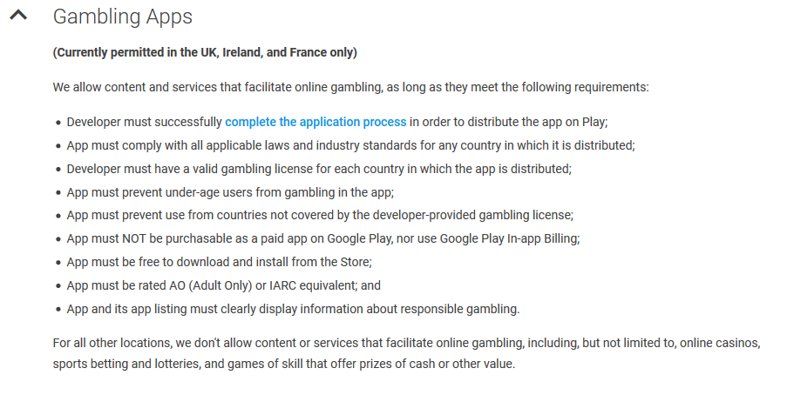
Double Six
DS
Deployment Environment
Google Play Developer Policy Centre

Slide 9

Double Six
Deployment Environment
Of the 2.6 million apps in the play store, 0.33% belong to the Casino category, 8.29% belong to the Education category and 7.43% percent belong to the Entertainment category. Other categories include Business, Lifestyle, Tools, Personalization etc. Double Six will be deployed in the Casino category adding to the 8,580 apps which make up that category.

Slide 10

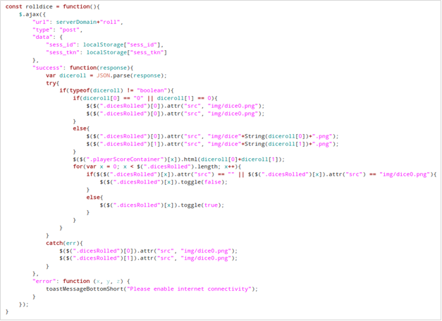
Double Six
Source Code for Rolling Dice

Slide 11
Double Six
Source Code for Rolling Dice Cont’d

Slide 12
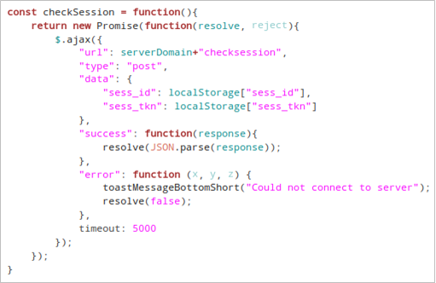
Double Six
Source Code for Verifying User Session

Slide 13


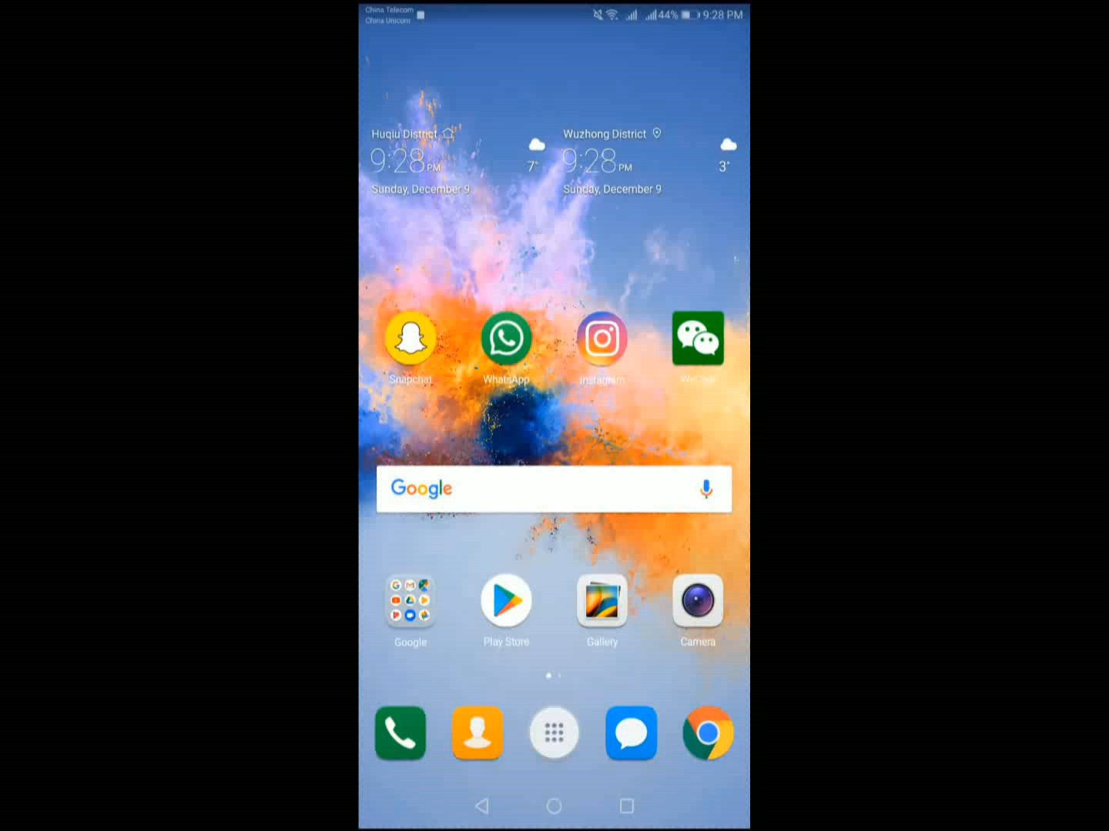
Double Six Demo

Slide 14
Thank You.
K.O.D Inc

